Slide 1


Data Ethics: The Algorithm made me do it!
School of Business, Law and Entrepreneurship
Online Learning Materiel

Slide 2
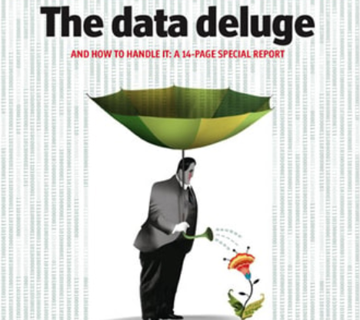

This session’s roadmap.
What we will be covering
Data Ethics
Data-Information-Knowledge-Wisdom and Ackoff’s Pyramid
Big Data & the Data Deluge
Algorithms & Algorithmic Bias

Slide 3
This session’s objectives.
Objectives of this session
Define Data Ethics
Describe applied examples of data ethics for ICT professionals
Explore issues around Artificial Intelligence (AI) and Algorithms
Focus on the Trolley Problem and MIT’s ‘The Moral Machine’
Identify useful tools for dealing with data ethics
Data Ethics Canvas
Identify areas for further exploration in your own time
Be more knowledgeable at the end of the session

Slide 4
This session’s ULOs.
Unit Learning Outcomes (ULOs).
2. Evaluate the role of standards, codes of conduct and legislative/regulatory obligations on the level of professionalism of the ICT industry
3. Review the roles and responsibilities of ICT professionals in organisations and society from a range of perspectives such as work-life balance, mentoring and life-long learning
What you need to do with this recorded presentation.
Watch, reflect and take your own notes in prep for the weekly live catchups or post into the general discussion board threads.
How long will this task take.
This task will take approx. 40 minutes to complete.

Slide 5

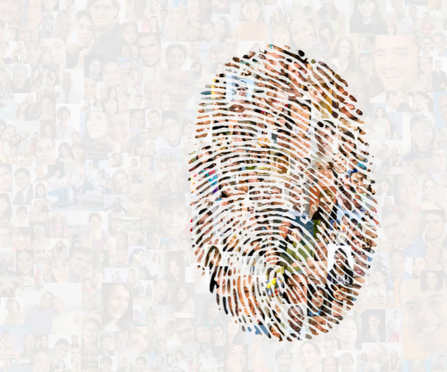



Slide 6
Data Ethics Defined.
Data ethics encompasses the moral obligations of gathering, protecting, and using personally identifiable information and how it affects individuals.
Responsible and sustainable use of data.
Considerable debate, both philosophical and legal, about the right, legitimate, and proper ways to use such data (Hand 2018).
Data ethics asks, “Is this the right thing to do?” and “Can we do better?”
In considering ethical matters, we must consider both current and future uses of data (Hand 2018).

Slide 7
Data’s primary purpose.
So, you’re ready to collect some data and start modeling, but how can you be sure that your data has been ethically sourced?
The recent European Union legislation, General Data Protection Regulation (GDPR), asserts no data can be collected until explicit consent for that purpose has been given and that consent can be retracted at any time.
This means that one Terms of Service agreement cannot give a company free-reign over a user’s data indefinitely.

Slide 8
What’s data? There are MANY definitions.
Merriam-webster Dictionary (2021) defines data as factual information (such as measurements or statistics) used as a basis for reasoning, discussion, or calculation.
The Cambridge Dictionary (2021) defines data as information, especially facts or numbers, collected to be examined and considered and used to help decision-making.
Computer data is information processed or stored by a computer.
This information may be in the form of text documents, images, audio clips, software programs, or other types of data.
Notes:
Merriam-Webster https://www.merriam-webster.com/dictionary/data
Cambridge Dictionary https://dictionary.cambridge.org/dictionary/english/data

Slide 9
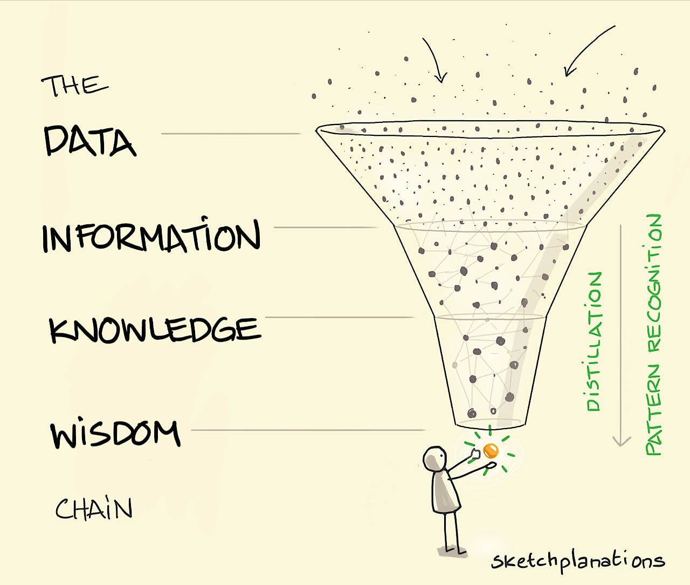

Data-Information-Knowledge-Wisdom (DIKW) & Ackoff’s Pyramid (1988).
Besides being causal and hierarchical, the distribution of the 4 elements is pyramidal, in that data are plentiful while wisdom is almost nonexistent (Bernstein 2009).
Data is the ‘new oil’.

Slide 10
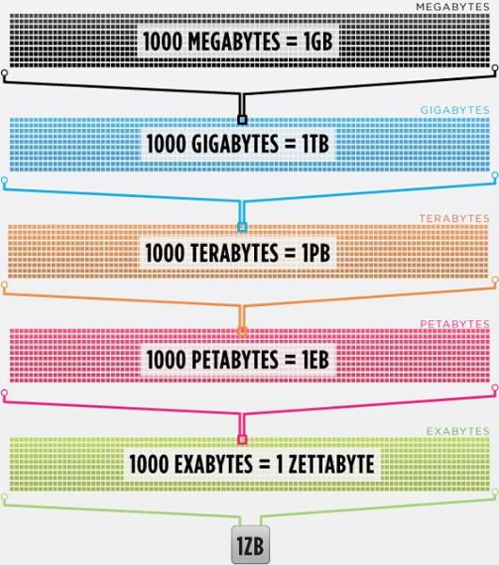
Big Data.
The large volume of data – both structured and unstructured – that inundates a business on a day-to-day basis. Different sizes from terabytes to zettabytes.
Derived from sensors, devices, video/audio, networks, log files, transactional applications, web, and social media — much of it generated in real time and at a very large scale.

Slide 11
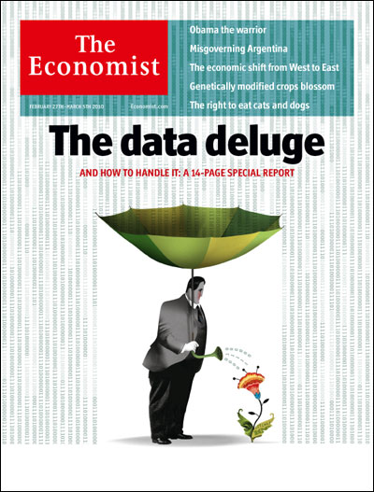
Big Data /2.

Slide 12
Algorithms.
“To make a computer do anything, you have to write a computer program.
To write a computer program, you have to tell the computer, step by step, exactly what you want it to do.
The computer then ‘executes’ the program, following each step mechanically, to accomplish the end goal. When you are telling the computer what to do, you also get to choose how it’s going to do it. That’s where computer algorithms come in.
The algorithm is the basic technique used to get the job done.” (How stuff works)

Slide 13
Algorithms /2.
The only point that explanation gets wrong is that you have to tell a computer “exactly what you want it to do” step by step.
Rather than follow only explicitly programmed instructions, some computer algorithms are designed to allow computers to learn on their own (i.e., facilitate machine learning).
Steps in getting dressed in the morning.

Slide 14
Algorithms / The Good & The Bad.
Precision: the steps are precisely stated.
Uniqueness: the results of each step are uniquely by defined and only depended on the input and result of the proceeding steps.
Finiteness: the algorithm stops after a finite number of instructions are executed.
Input: the algorithm receives input.
Output: the algorithm produces output.
Generality: the algorithm applies to a set of inputs.
Effectiveness: An algorithm is also generally expected to be effective. This means that all of the operations to be performed in the algorithm must be sufficiently basic that they can in principle be done exactly and in a finite length of time.

Slide 15
Algorithms / The Good & The Bad.
Because algorithms are written by humans, bias may be intentionally or unintentionally present. Biased algorithms can cause serious harm to people.
You can't trust everything to Artificial Intelligence. When Amazon used AI for recruiting new developers and other techies, it later realised the algorithm was filtering out women in favor of men. Hmmm.
A study from MIT found that gender classification systems sold by several major tech companies had an error rate as much as 34.4 percentage points higher for darker-skinned females than lighter-skinned males.
Notes:
https://www.newscientist.com/article/2166207-discriminating-algorithms-5-times-ai-showed-prejudice/#ixzz6xeV5UOuM

Slide 16
Algorithms / The Good/The Bad/The Ugly.
Already in use in several US states, PredPol is an algorithm designed to predict when and where crimes will take place, with the aim of helping to reduce human bias in policing. But in 2016, the Human Rights Data Analysis Group found that the software could lead police to unfairly target certain neighbourhoods.
Sometimes artificial intelligence feeds back to heighten human bias. In October 2017, police in Israel arrested a Palestinian worker who had posted a picture of himself on Facebook posing by a bulldozer with the caption “attack them” in Hebrew. Only he hadn’t: the Arabic for “good morning” and “attack them” are very similar, and Facebook’s automatic translation software chose the wrong one. The man was questioned for several hours before someone spotted the mistake.
Facebook was quick to apologise.
Notes:
https://www.newscientist.com/article/2166207-discriminating-algorithms-5-times-ai-showed-prejudice/#ixzz6xeV5UOuM

Slide 17


